Slide 1
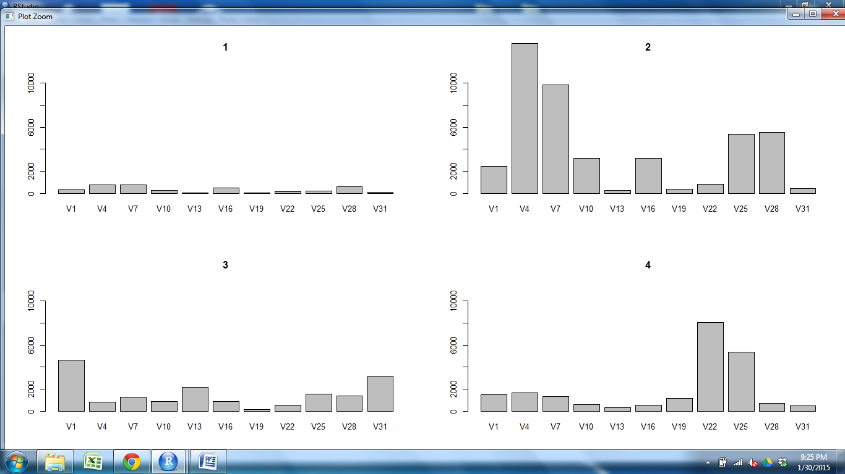
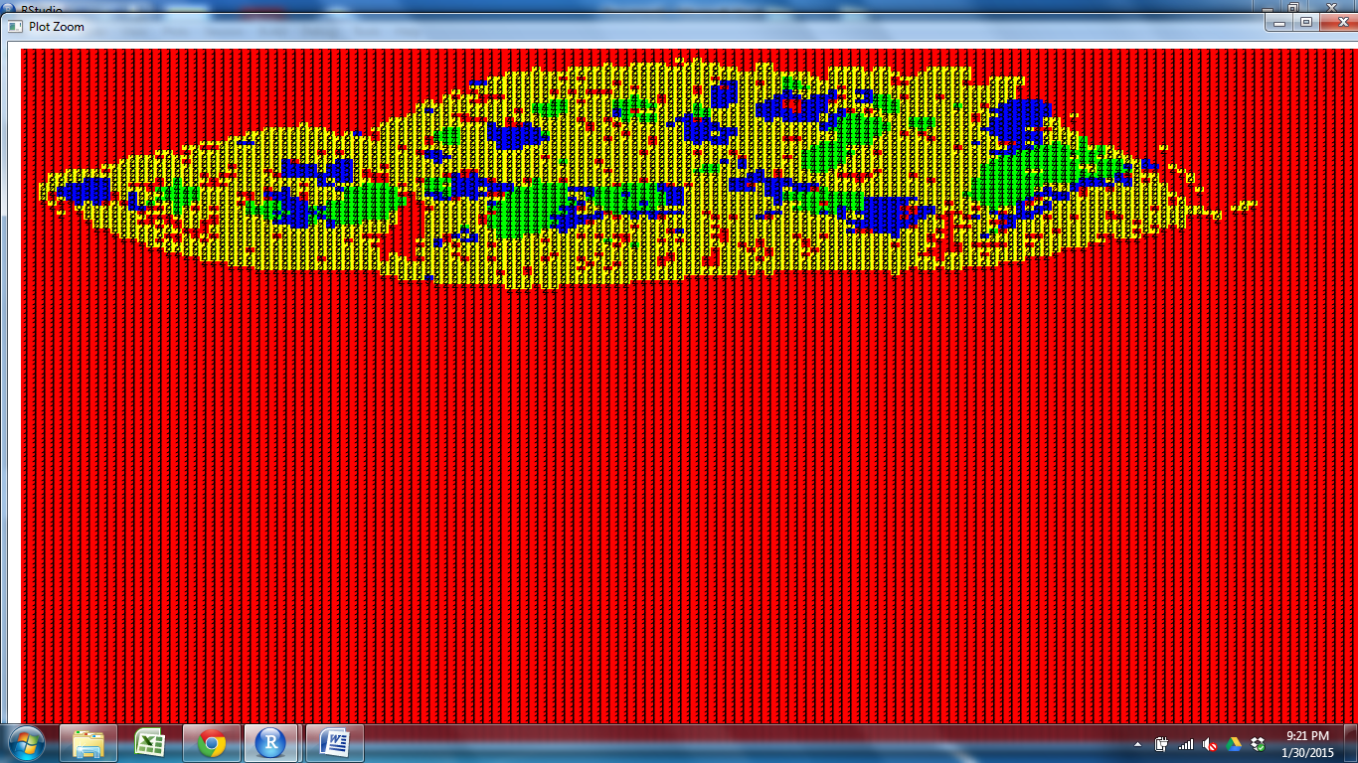
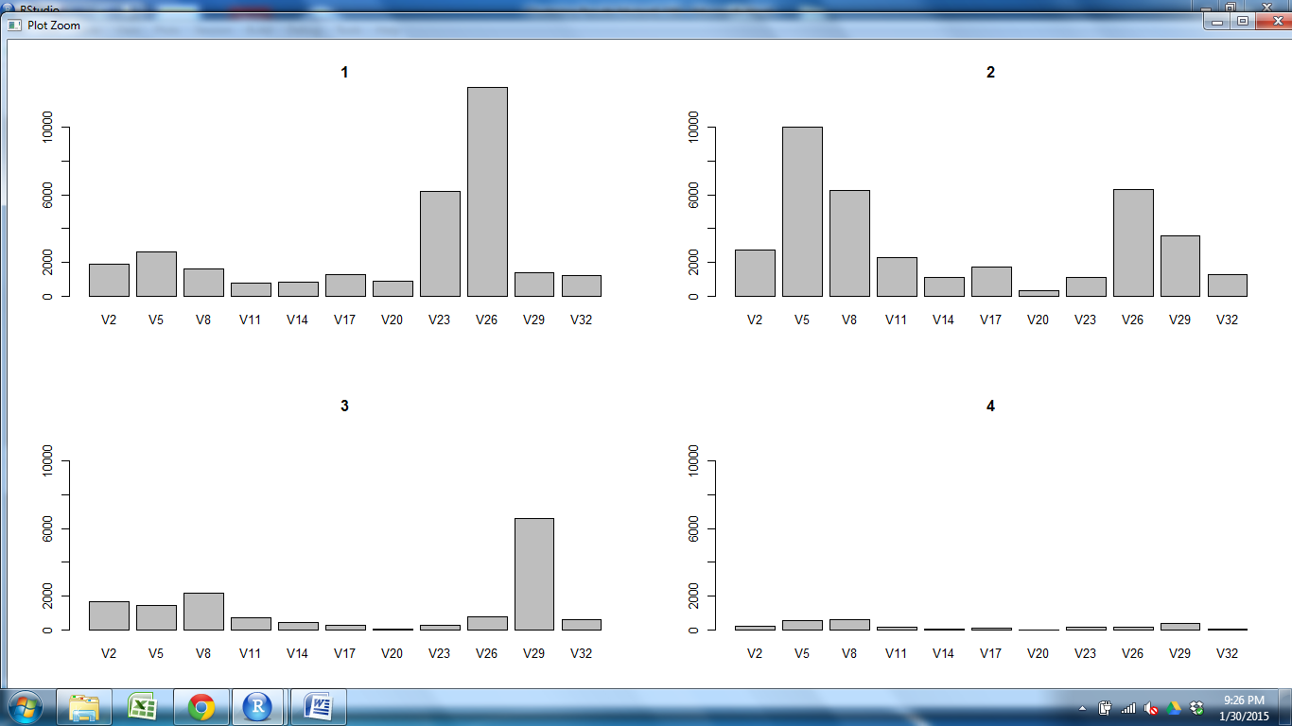
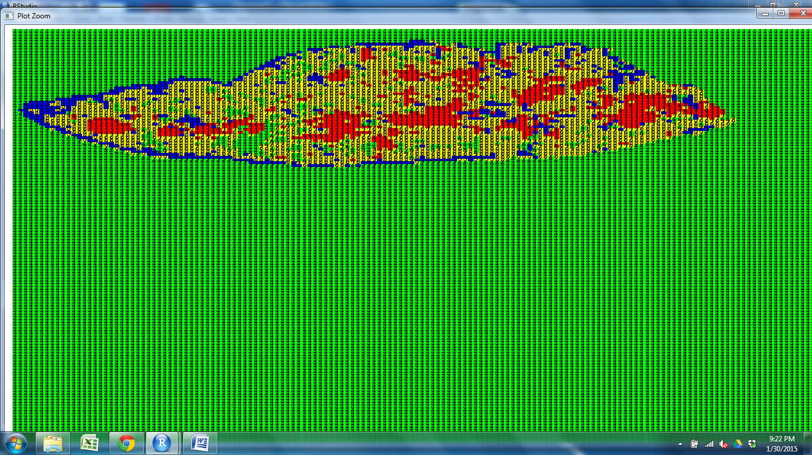
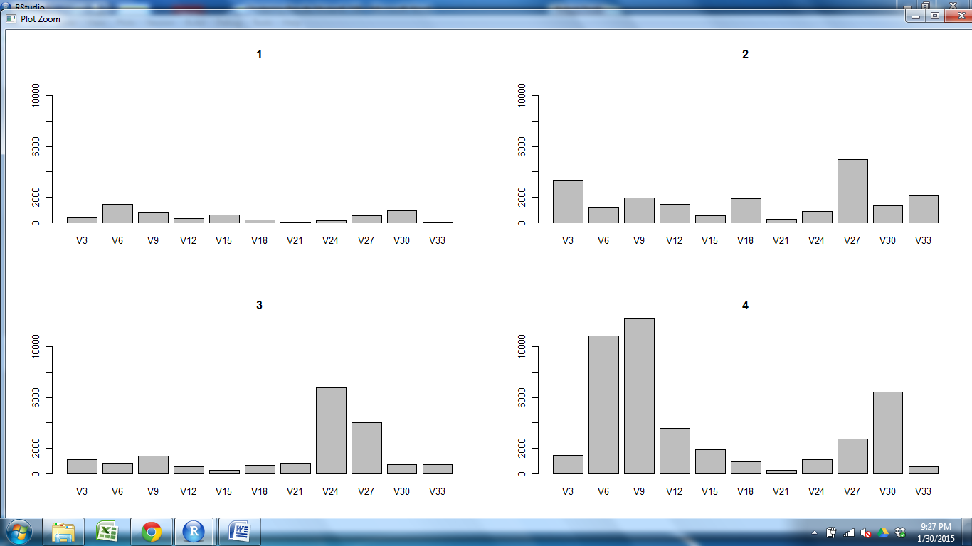
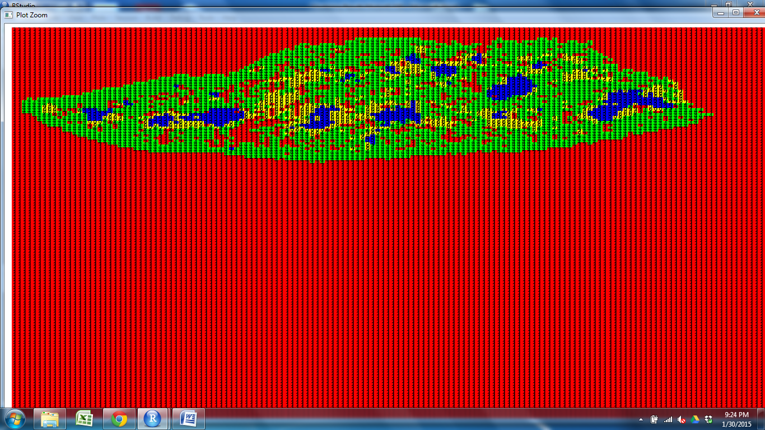
CD11c CD205 CD31 Claud34 Claud5 Foxp3 K14 K5 PDGFRb UEA1

Slide 2
CD11c CD205 CD31 Claud34 Claud5 Foxp3 K14 K5 PDGFRb UEA1

Slide 3
CD11c CD205 CD31 Claud34 Claud5 Foxp3 K14 K5 PDGFRb UEA1

Slide 4
CD11c CD205 CD31 Claud34 Claud5 Foxp3 K14 K5 PDGFRb UEA1

Slide 5
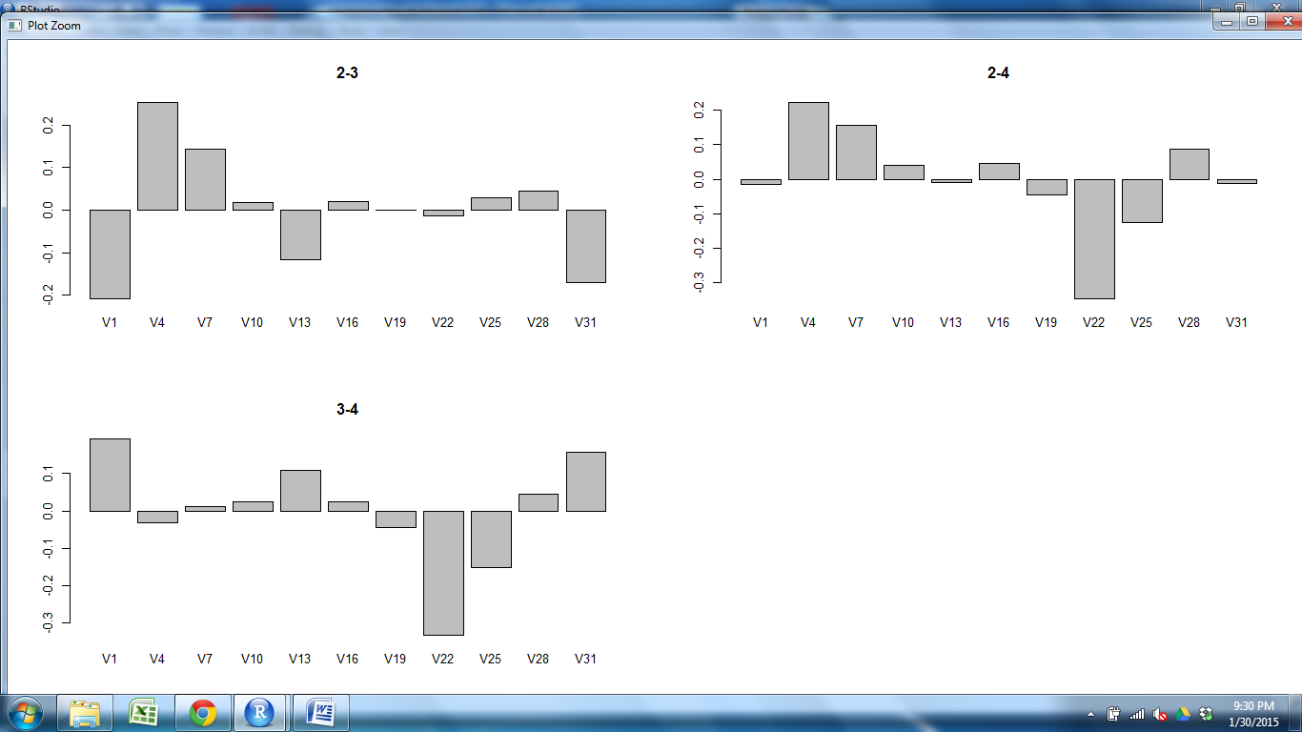
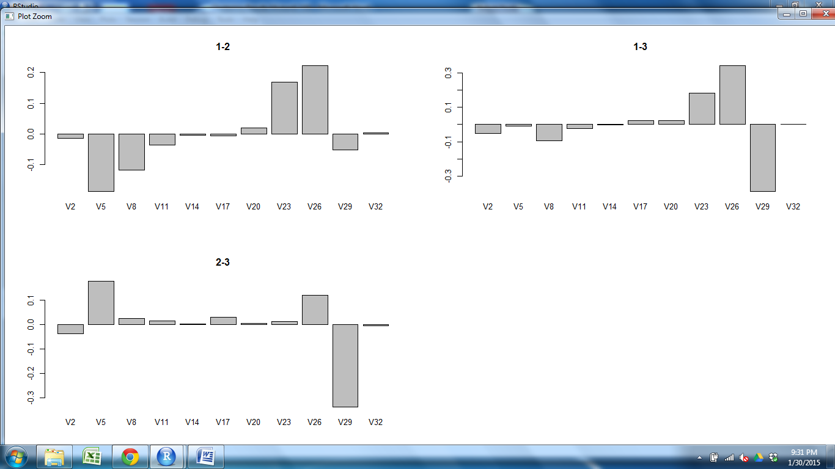
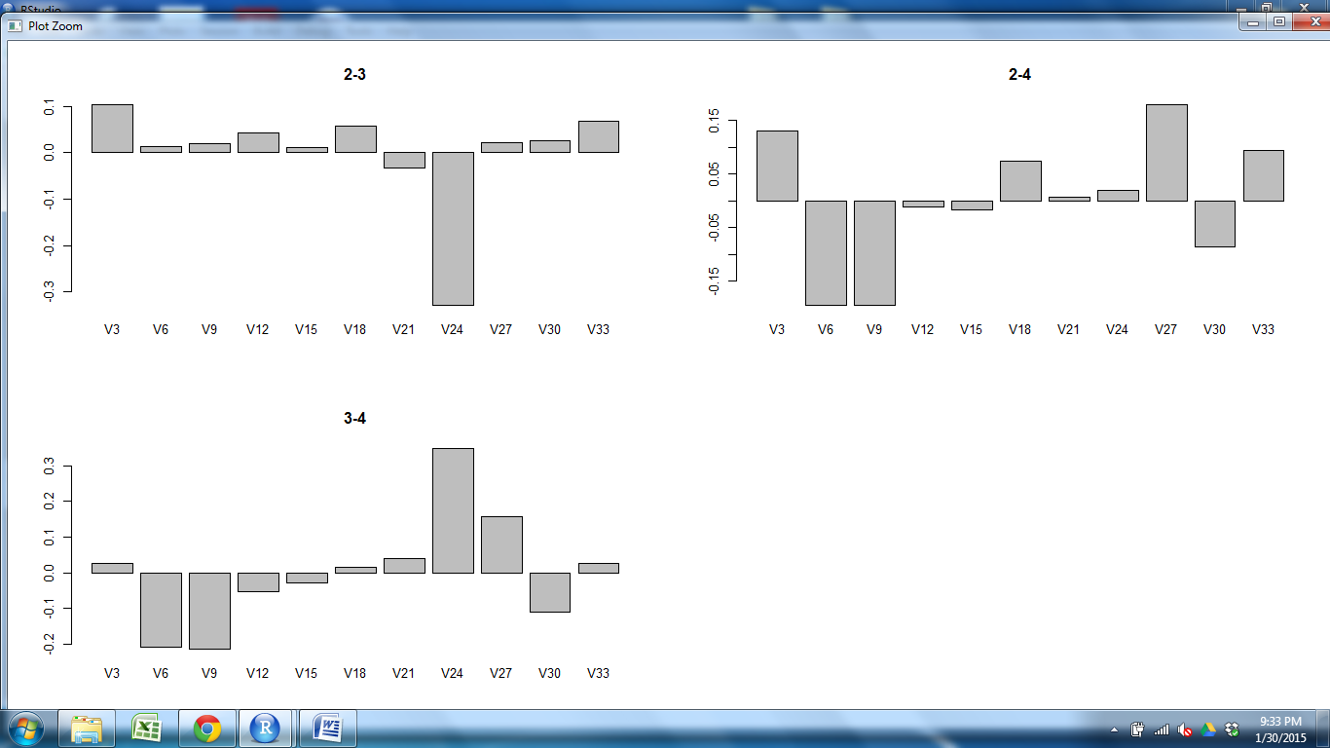
CD11c CD205 CD31 Claud34 Claud5 Foxp3 K14 K5 PDGFRb UEA1

Slide 6
CD11c CD205 CD31 Claud34 Claud5 Foxp3 K14 K5 PDGFRb UEA1

Slide 7
CD11c CD205 CD31 Claud34 Claud5 Foxp3 K14 K5 PDGFRb UEA1

Slide 8
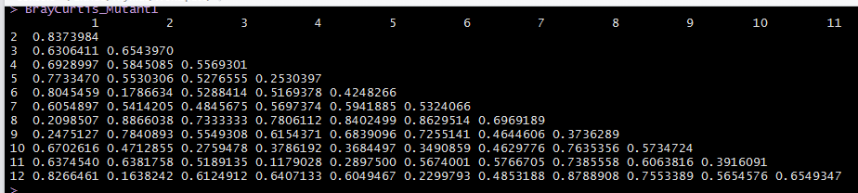
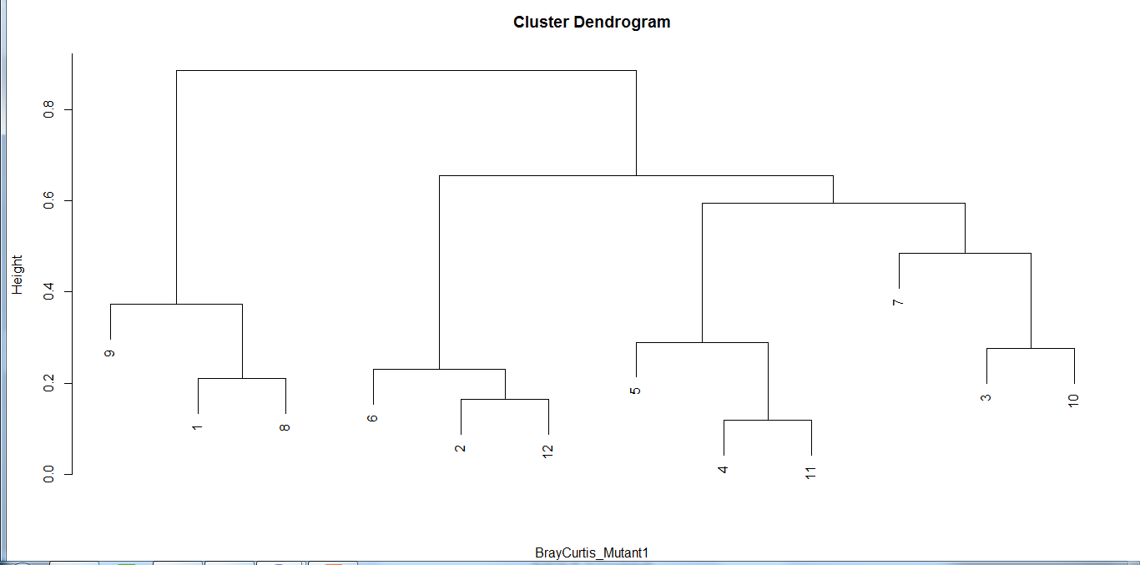
Mutant1 150
Outer Cortex M1 M2 M2 M1 Cortex Outer Outer M1 M2
Cortex
M1
M2
M2
M1
Cortex
Outer
Outer
M1
M2
Cortex
S3Outer S1Outer, S2Outer S2M1 S1Cortex S3Cortex S2M2 S1M2 S2M2 S2Cortex S1M1 S3 M1

